Slide 1





LUNG CANCER PREDICTION
Team : Guide : Saomya Chaudhury
P.Yohitha- patrapalliyohitha@gmail.com Master Trainer, Edunet Foundation.
R.Nikitha- nikhitharayudu961@gmail.com
N.SML Manjusha- nsmlmanjusha@gmail.com
Disclaimer: The content is curated for educational purposes only.
Notes:
Slides: Prepare a short slide deck (10-12 slides) summarizing the project objectives, methodology, and key results.

Slide 2
OUTLINE
Abstract of the Project
Problem Statement
Proposed Solution
System Architecture
Live Demo of the Project
Embedded Video of Project
Conclusion
Future Scope

Slide 3
Abstract
This study presents the development of a machine learning model that predicts the risk of lung cancer by analyzing various health factors, including lifestyle choices, medical history, and symptoms. The model aims to address challenges in early diagnosis, treatment planning, and personalized care by providing accurate and timely predictions of lung cancer risk. Additionally, the system empowers healthcare professionals with actionable insights, promotes preventative health practices, mitigates risks associated with smoking, age, and chronic diseases, and supports research and innovation in oncology. Ultimately, the model serves as a critical tool for fostering early detection, improving patient outcomes, and enhancing healthcare efficiency in the fight against lung cancer.

Slide 4
Problem Statement
In the face of increasing health risks, resource constraints in healthcare, and growing demands for early detection and treatment, how can we accurately predict the risk of lung cancer for different individuals based on historical health data and environmental factors? Furthermore, how can such predictions help stakeholders—healthcare providers, policymakers, and researchers—optimize resource allocation, improve early diagnosis, and implement personalized treatment strategies to address real-time challenges in healthcare?

Slide 5
Proposed Solution
To address the problem of accurately predicting the risk of lung cancer and enabling better healthcare decision-making, a machine learning model is proposed. The model leverages historical health data, environmental factors, and lifestyle information to predict the likelihood of lung cancer using algorithms like Random Forest, Decision Tree, and others. It provides actionable insights for healthcare professionals, policymakers, and researchers, promoting early detection, personalized treatment plans, and improved patient outcomes.
Practical Applications:
Healthcare Providers: Identify high-risk individuals, recommend targeted screening programs, and optimize resource allocation for early diagnosis and personalized treatment. Policymakers: Forecast lung cancer trends, allocate healthcare resources effectively, and develop policies to reduce risk factors like smoking and pollution.
Researchers: Study the impact of environmental factors, lifestyle choices, and genetics on lung cancer development to drive innovations in prevention, diagnosis, and treatment. Patients: Access predictive tools to assess their individual risk, enabling them to take preventive measures or seek early medical intervention.



Slide 6
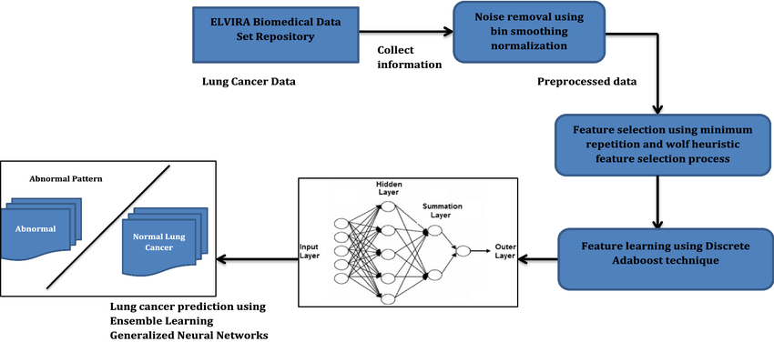
System Architecture

Slide 7
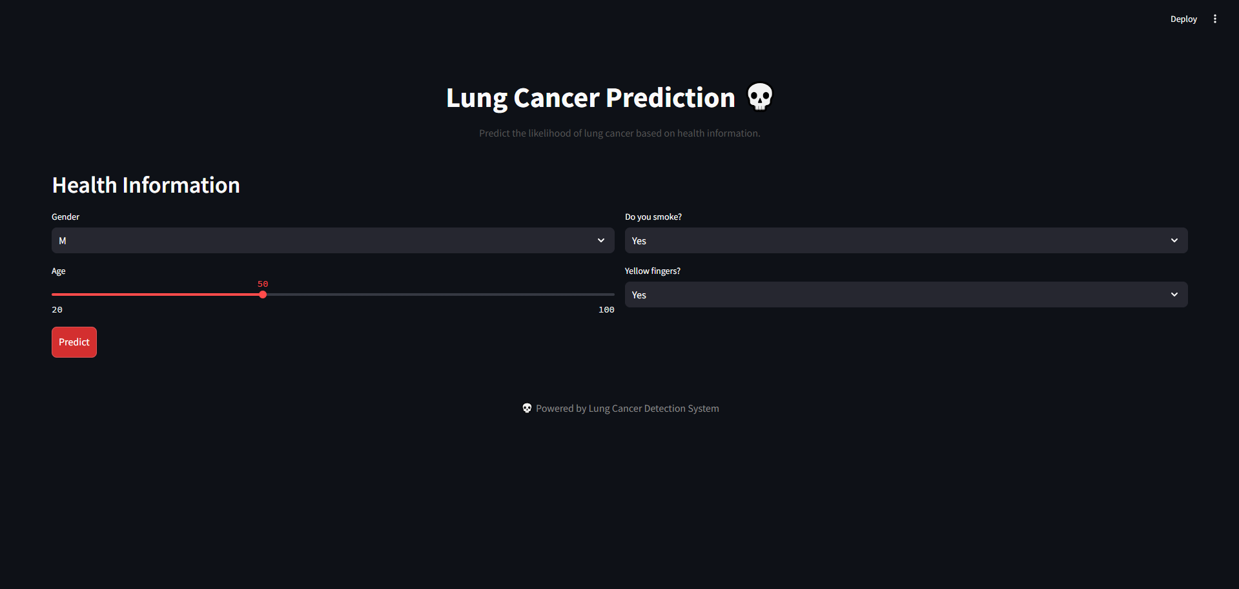
Live Demo of Project

Slide 8
Video of Project Demo

Slide 9

Conclusion
This proposed solution leverages machine learning to develop a comprehensive lung cancer risk prediction system. By integrating health data, environmental factors, and lifestyle information, the model offers accurate predictions that address real-world healthcare challenges. It enables early detection, supports personalized treatment, and improves patient outcomes, contributing to more efficient healthcare systems. Ultimately, the model aims to advance cancer research, reduce healthcare disparities, and play a pivotal role in combating lung cancer globally, promoting better health outcomes and sustainability in healthcare practices.

Slide 10
Future Scope
The lung cancer prediction model offers potential to:
Enhance early detection through personalized risk assessments, enabling proactive healthcare interventions.
Optimize healthcare resources by identifying high-risk individuals and prioritizing screening and treatment.
Support precision medicine by providing tailored treatment recommendations based on individual risk profiles and health conditions.
Advocate for public health policies focused on prevention, smoking cessation, and environmental exposure reduction.
Foster ongoing research into the genetic, environmental, and lifestyle factors contributing to lung cancer risk, leading to novel therapeutic approaches.
By leveraging the power of machine learning, this model not only empowers healthcare professionals to make informed decisions but also contributes to global efforts in reducing lung cancer mortality and improving public health outcomes.

Slide 11
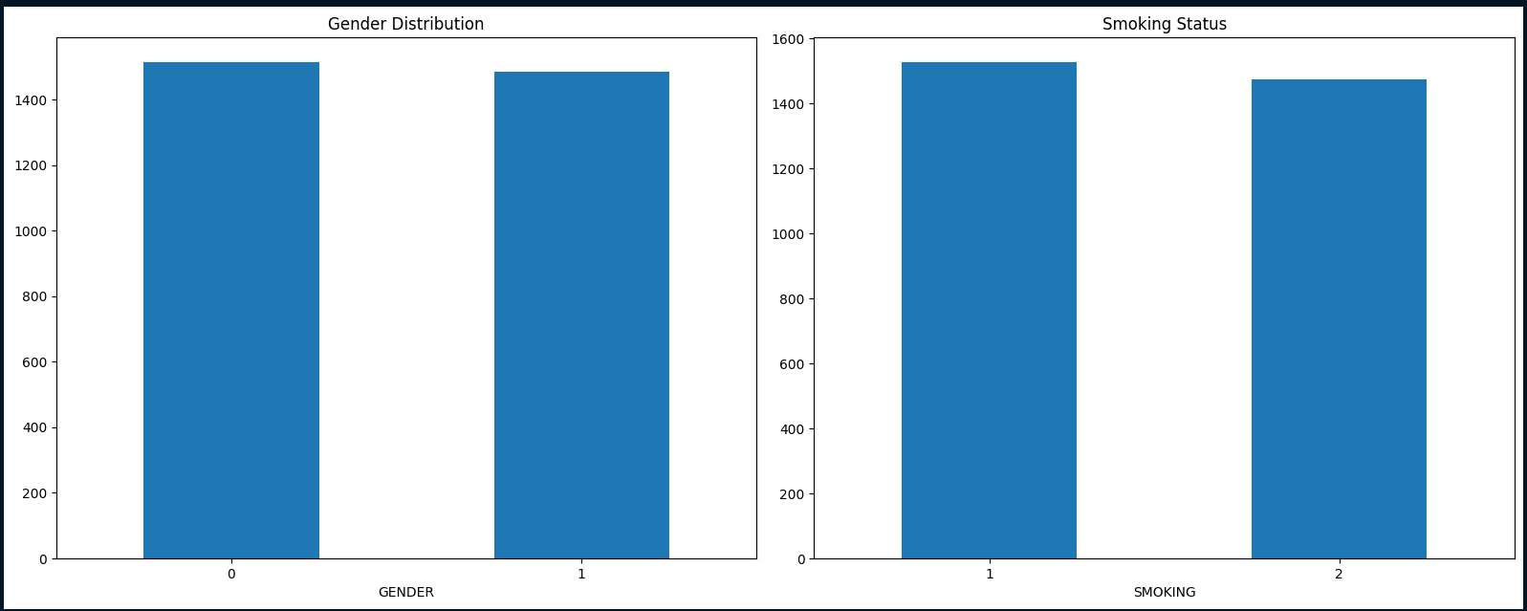
1.Gender Distribution
Objective: To understand the distribution of gender in the dataset.
Visualization: Bar chart displaying the count of each gender category (e.g., Male, Female).
Insights:
Helps identify any gender imbalance in the dataset.
Useful for analyzing gender-specific trends in lung cancer prediction.
2. Smoking Status
Objective: To examine the proportion of individuals who smoke.
Visualization: Bar chart showing the count of smokers and non-smokers.
Insights:
Highlights the prevalence of smoking in the population.
Useful for assessing the impact of smoking as a risk factor for lung cancer.
Can reveal if smoking is a significant variable in the dataset.

Slide 12
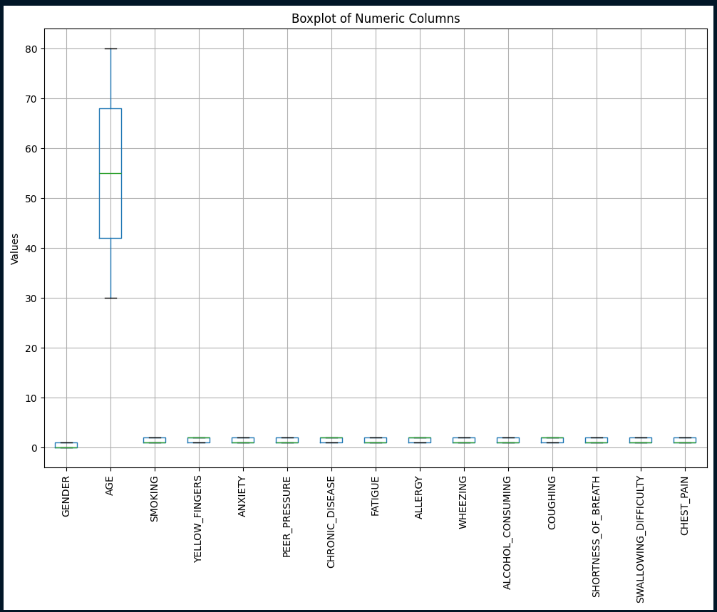
Median: The central line in each box shows the typical value for each column.
Spread: The box (IQR) shows the middle 50% of values; longer boxes mean more variability.
Outliers: Points outside the whiskers indicate rare cases or potential data issues.
Comparison: Boxplots help compare ranges and variability across columns; scaling may be needed for machine learning.

Slide 13
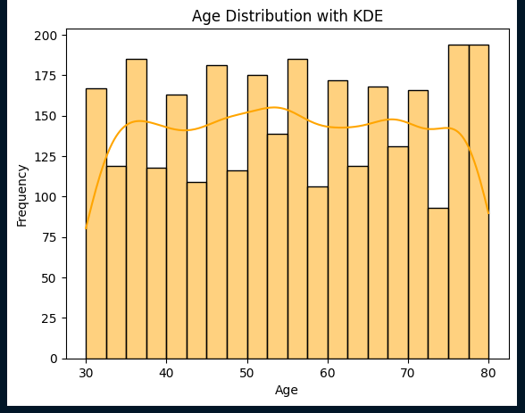
Age Distribution: The histogram shows how ages are spread, with KDE peaks highlighting common age ranges.
Frequency: Bar heights indicate the count of individuals in each age range.
Trends: The KDE curve smooths the data, showing patterns like normality, skewness, or multiple peaks.
Insights: Helps identify age groups most at risk or for further segmentation.

Slide 14
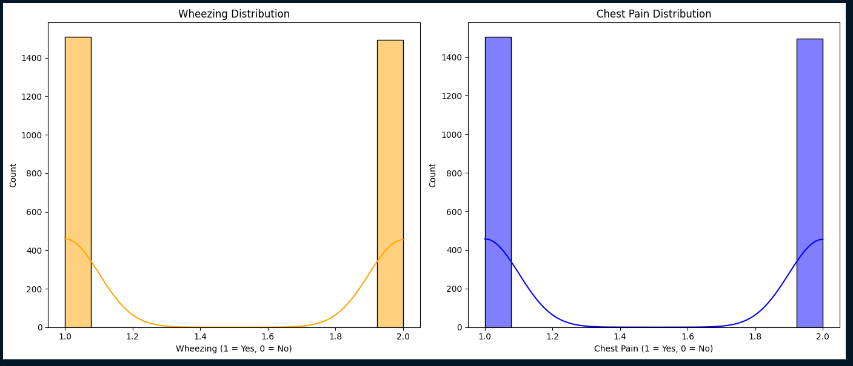
Wheezing Distribution
Insights:
Shows how many individuals experience wheezing.
High wheezing frequency (1 = Yes) may indicate respiratory issues.
The KDE curve smooths the trend for better analysis.
Suggestions:
Study links between wheezing and symptoms like COUGHING or SHORTNESS_OF_BREATH.
Investigate its correlation with LUNG_CANCER.
Chest Pain Distribution
Insights:
Displays how many individuals report chest pain.
High chest pain frequency (1 = Yes) might point to severe conditions.
The KDE curve highlights patterns in chest pain occurrence.
Suggestions:
Compare chest pain across age groups or genders.
Analyze its combined effect with variables like SMOKING or ANXIETY for lung cancer prediction.
4o

Slide 15
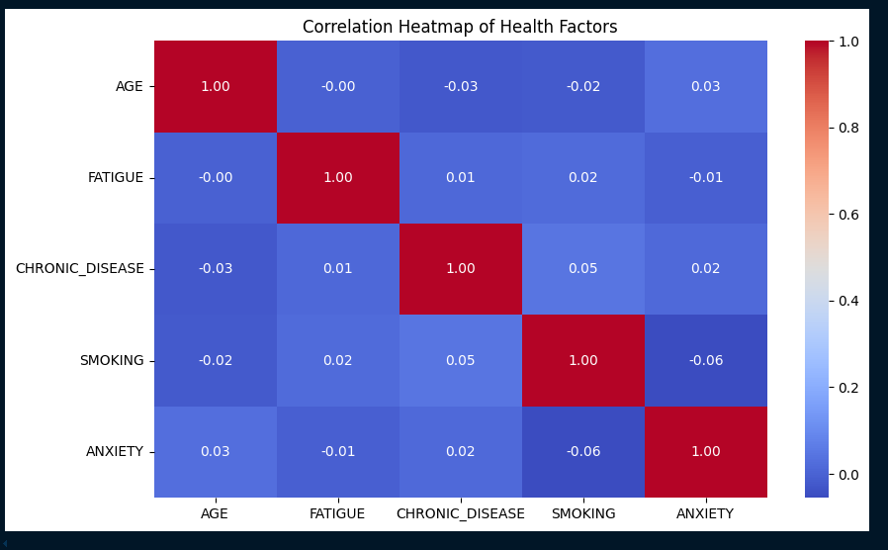
Correlation Heatmap Insights
Positive Correlation: Closer to +1 means both variables increase together.
Negative Correlation: Closer to -1 means one variable increases as the other decreases.
No Correlation: Values near 0 mean no strong relationship.
Key Relationships
Age: Check if AGE correlates with factors like FATIGUE or CHRONIC_DISEASE for age-related trends.
Smoking and Chronic Disease: A positive correlation may indicate smoking’s impact on long-term health.
Anxiety and Fatigue: A positive correlation might show anxiety contributing to fatigue, linking mental and physical health.
Overall Trends: Strong correlations highlight key relationships; weak ones suggest independence between variables.

Slide 16
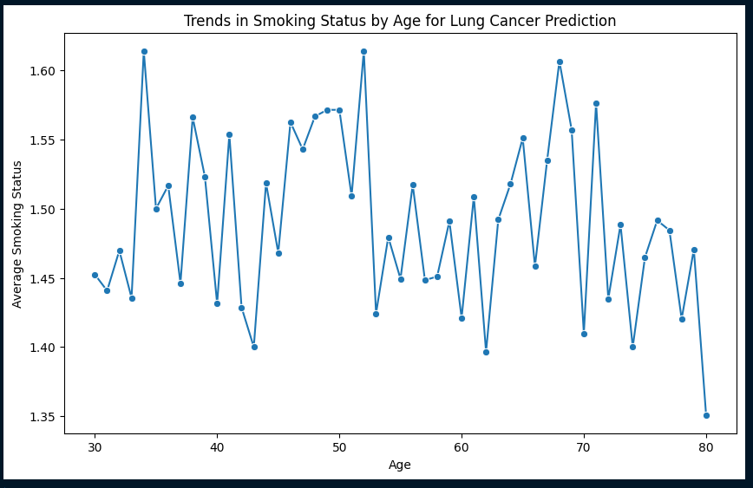
Age vs Smoking Status Insights
Age and Smoking Trend:
Shows how smoking behavior changes with age.
Younger individuals may smoke less, while older individuals may smoke more—or vice versa.
Smoking Prevalence:
An increasing trend with age suggests smoking is a key factor in lung cancer risk.
A decreasing trend may indicate more quitting with age.
Lung Cancer Prediction:
Patterns help predict lung cancer risk based on age and smoking history.

Slide 17
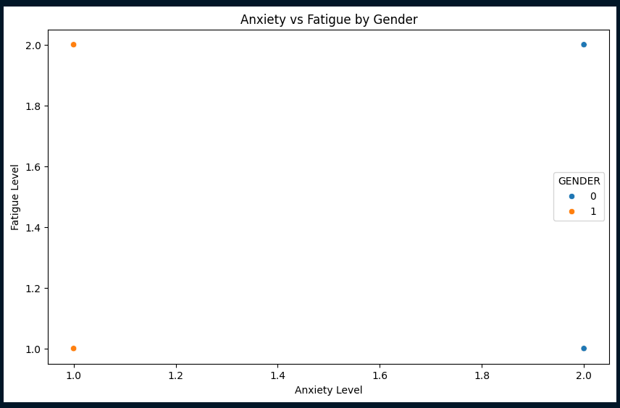
Anxiety vs Fatigue Insights by Gender
Anxiety and Fatigue Relationship:
A positive correlation means higher anxiety often coincides with higher fatigue.
Gender-Based Differences:
Color-coded points reveal differences in anxiety and fatigue levels between males and females.
Clusters:
Tight clusters suggest consistent anxiety and fatigue levels; scattered points indicate varied experiences.
Outliers:
Unusual points may represent individuals with extreme anxiety or fatigue levels.

Slide 18
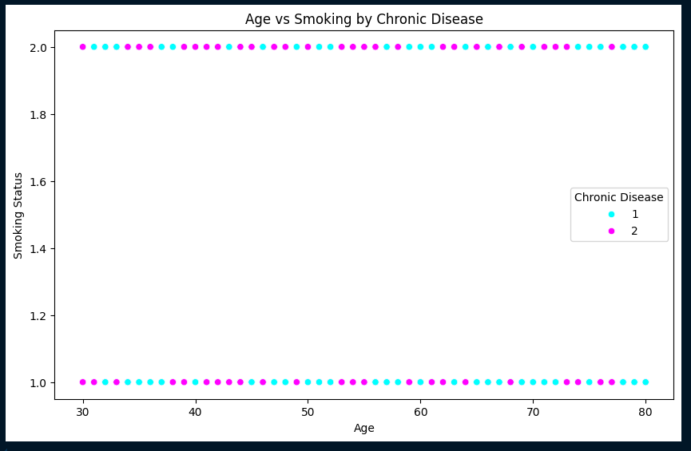
Visualization Description
Objective: To explore the relationship between AGE and SMOKING while categorizing the data by the presence of CHRONIC_DISEASE.
Visualization: A scatter plot where:
X-axis represents AGE.
Y-axis represents SMOKING (coded typically as 0 for non-smoker, 1 for smoker).
Data points are colored by CHRONIC_DISEASE using the cool palette to visually differentiate between those with and without chronic disease.

Slide 19
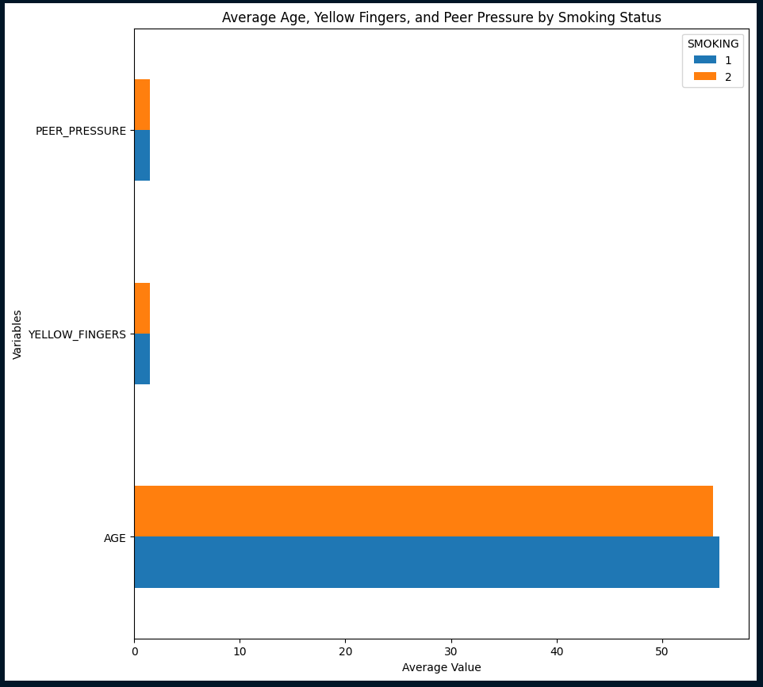
This horizontal bar chart visualizes the average values of AGE, YELLOW_FINGERS, and PEER_PRESSURE for smokers and non-smokers. Each bar represents the mean of the respective variable, grouped by smoking status. The chart highlights differences in these factors between smokers and non-smokers, helping to identify trends such as whether peer pressure or yellow fingers are more associated with smoking habits.

Slide 20
Thank you!
Notes:
thank you very much for joining this PPT, keep learning.
20

